Slide 1
Software Startups
Prof. Dr. Dirk Riehle
Friedrich-Alexander University Erlangen-Nürnberg
COSS D01
Licensed under CC BY 4.0 International
Notes:
It is Friedrich-Alexander University Erlangen-Nürnberg – FAU, in short.
Corporate identity wants us to say “Friedrich-Alexander University”.

Slide 2
Agenda
Definition (startup)
The search process
Problem-solution fit
Product-market fit
Product-channel fit
Startup metrics

Slide 3
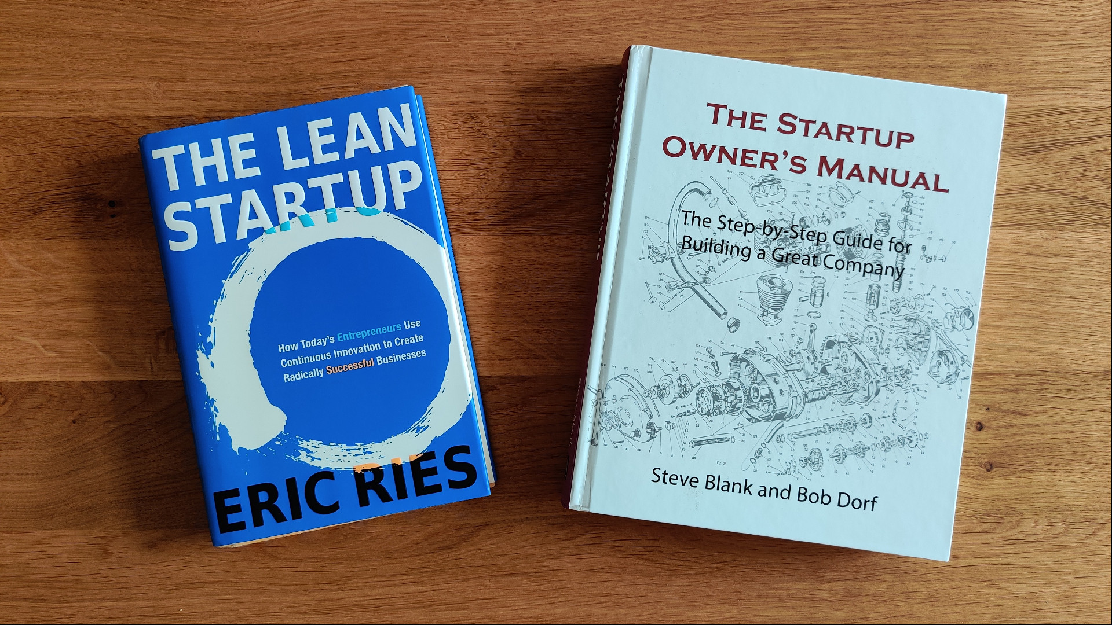

Slide 4
1. Startup Definition

Slide 5
What is a Startup?
A startup
  Is an organization in search of a viable business model
  Is not a small version of a large company

Slide 6
Sources of Innovation and Their Risk Profiles
Industrial
research lab
(e.g. cure for cancer)
University
research lab
(e.g. the internet)
High
Invention risk
Product line
organizations
(e.g. another sneaker)
Independent
entrepreneurs
(e.g. mobile phone
for the elderly)
Low
Low
High
Customer / market risk

Slide 7
2. The Search Process

Slide 8
The Road to Failure
Because you have this great idea
  You know what the customer wants or needs
    You know what features satisfy the customer
  You don’t need to allow for iteration and learning
    You can set a launch date and work backwards
    You can already focus on execution and efficiency
  You can bring in people from established firms
All everyone needs to do is to execute your plan

Slide 9
How to Avoid Failure
Establish and follow a structured process of incremental “validated learning” where
  A structured process is a process of incrementally discovering your business model
  And learning is a process of creating, testing, and evaluating hypotheses
You therefore start with an idea, but do not assume it is true

Slide 10
Incremental Learning Needs Feedback
“There are no facts inside your building.” (Various authors.)

Slide 11
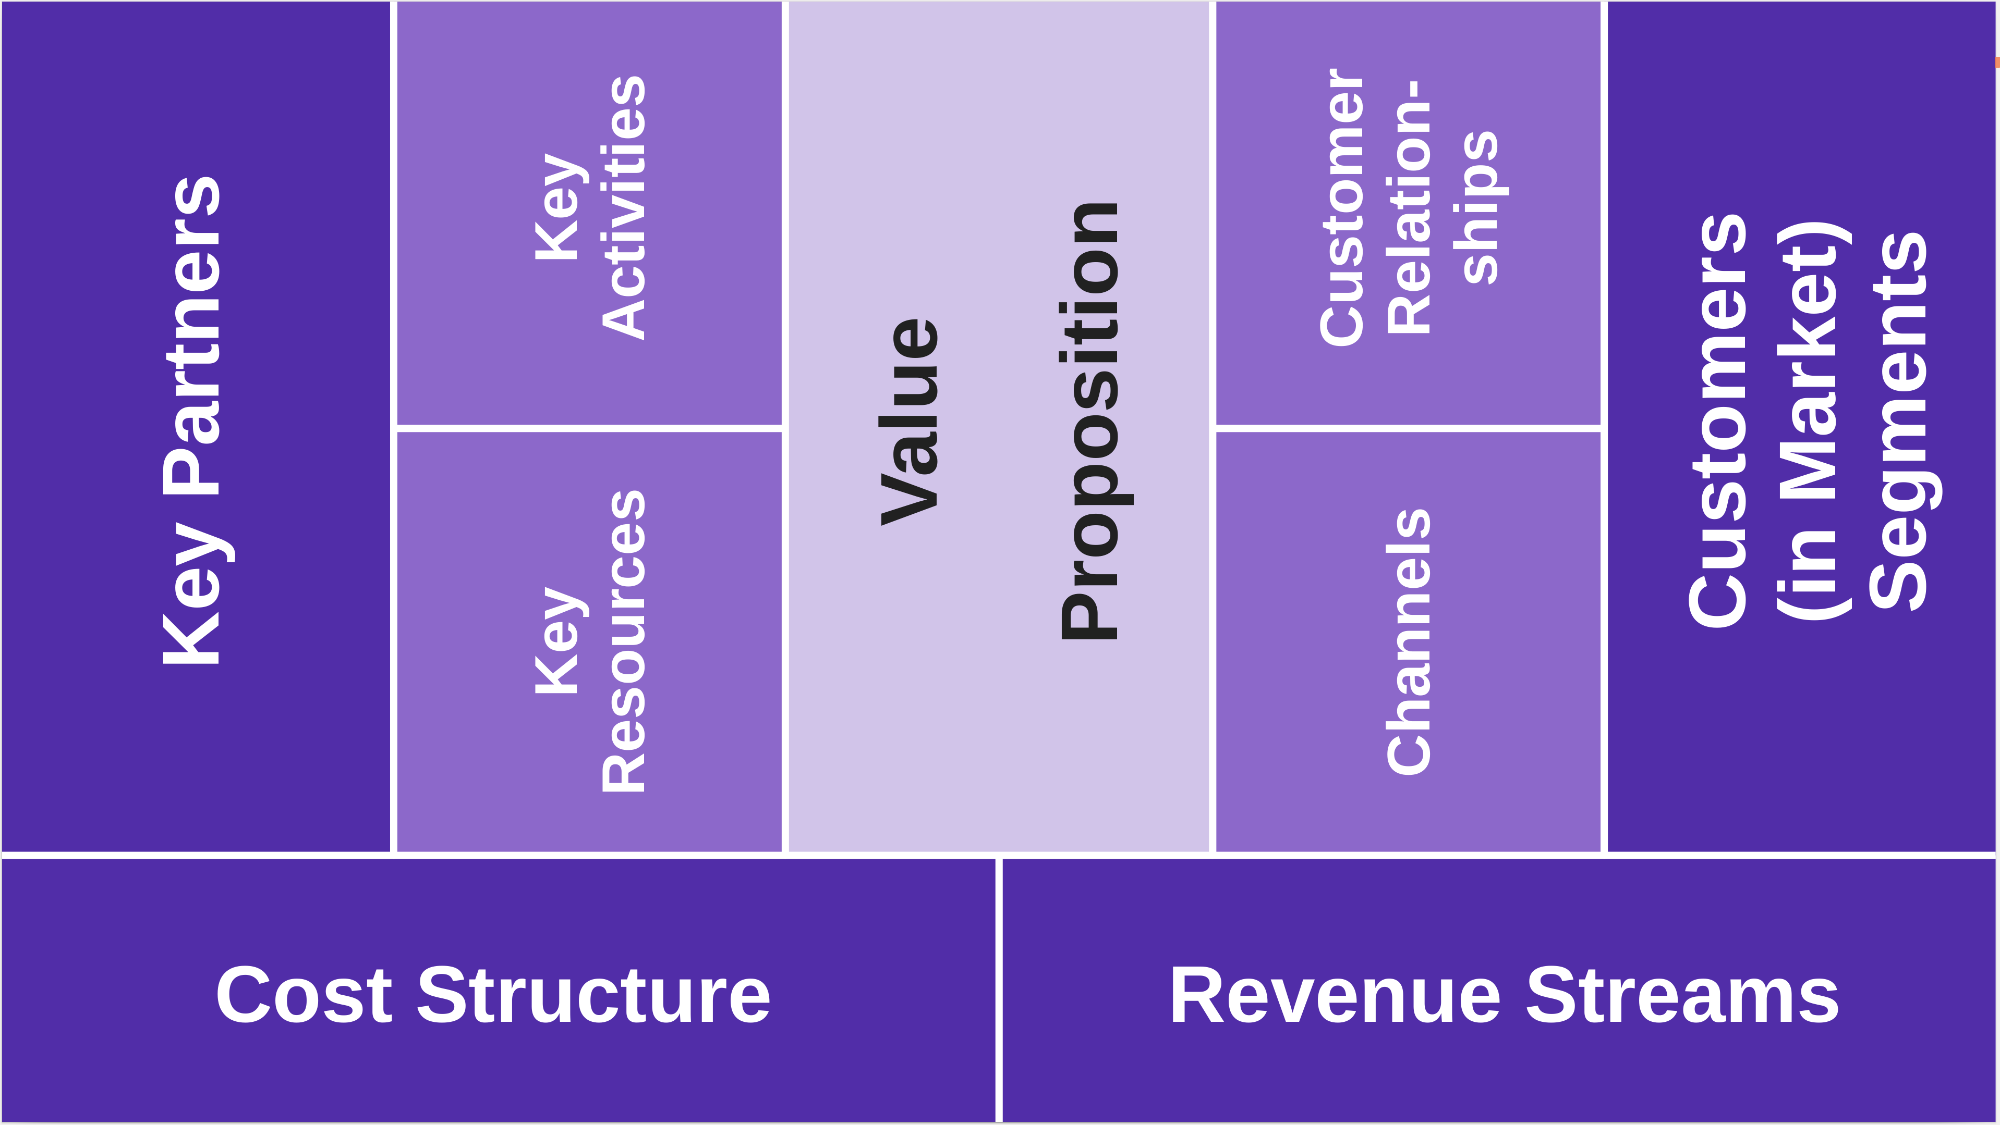
The Role of the Business Model Canvas in the Search
Value creation
Value capture

Slide 12
The Three Challenges of the Search Process
The business model achieves
  Problem-solution fit
  Product-market fit
  Product-channel fit
Product-channel fit
Product-market fit
Problem-solution fit

Slide 13
The Three Challenges Defined
Problem-solution fit (basic fit)
  Is reached when a value proposition matches a market segment
  Customers want it, you can provide it, and they will pay for it
Product-market fit (scale up)
  Is reached when the product satisfies (“fits”) its market
  Both # of customers and revenues are growing commensurate with market
Product-channel fit (scale out)
  Is reached when products efficiently (growth, throughput) reach their markets
  Products utilize different channels, are customized for these channels

Slide 14
The Two Activities in Each Challenge of the Search Process
Business model building
  Creating coherent sets of hypotheses (descriptive statements) about the business
Business model validation
  Testing hypotheses from the business model to gather feedback

Slide 15
1. Business Model Building as Hypothesis Creation
Create hypotheses from (initial) creative spark and (later) feedback loop
  The creative spark provides the initial potentially disruptive ideas
  Experimental feedback guides development and refinement

Slide 16
2. Business Model Validation Using Hypothesis Testing
4
Derive
insight
1
Select
hypothesis
3
Test
hypothesis
2
Design
experiment

Slide 17
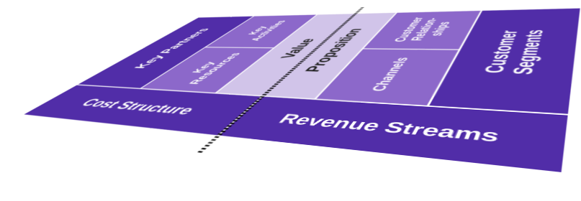
The Business Model Canvas Over Time
time
Iteration 3
Iteration 2
Iteration 1

Slide 18
Dimensions for Business Model Canvas Design
Variants
  You experiment with different variants of the canvas
Markets
  You design different models for different market
Evolution
  You revise the business model canvas as you learn

Slide 19
Pivot or Proceed
A pivot
  Is a change of direction
    Based on a change in the underlying assumptions (idea) of the business
    Basically, you have been climbing the wrong hill
  Is triggered by experimental learning
  Is not a failure

Slide 20
Benefits of the Search Approach
Time efficient
Resource efficient
  Both capital and labor
Still, an efficient search requires experience

Slide 21
Model Correlations
Various
Problem-solution fit
Product-market fit
Product-channel fit
...
Blank [1]
Ries [2]
Customer discovery
Customer validation
Customer creation
...
Moore &
McKenna [3]
Innovators
Early adopters
Early majority
...
time
[1] Blank, S. (2005). Four steps to the epiphany.
[2] Ries, E. (2011). The lean startup.
[3] Moore, G. A., & McKenna, R. (1999). Crossing the chasm.

Slide 22
3. Problem-Solution Fit

Slide 23
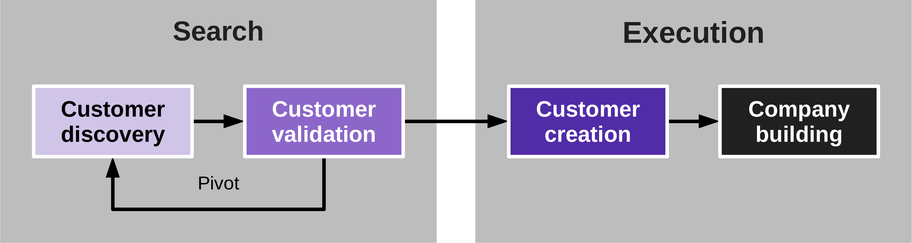
Finding Problem-Solution Fit with Customer Discovery
Customer discovery is a search process that
  Tests whether the hypothesized business model fundamentally works
Problem / solution fit
  Is the matching of a value proposition with a market segment
  Customers want it, you can provide it, and they will pay for it

Slide 24
From Product Vision to Business Model
Founders often have a product vision
  Assumed value proposition
But what about
  Market segments
  Channels
  Customer relationships
  Revenue streams
  Key partners
  Key resources
  Key activities
  Cost structure

Slide 25
Start the Search with Market Sizing
Start with a market size assessment
  Too small a market
    Makes you unfundable by venture capitalists
    May not meet your own expectations
This way, you start in a good spot
Total market
Addressable
market
Serviced
market

Slide 26
Market Types and Business Models
Existing
market
New
market
New
Product
Resegmented
market
Cloned
market
Existing
Existing (old)
New
Market

Slide 27
The Impact of Different Market Situations
A new product in an existing market
  Market is known, little uncertainty
  Product has efficiency gains
A new product for a new market
  No market yet; evangelism needed
  Breakthrough product
Resegmenting an existing market
  Market is known, little uncertainty
  Product focus on low-cost or niche
Cloning into a new market
  Market can be reasonably guessed
  Product is well understood

Slide 28
Market Types (Commercial Open Source)
SugarCRM
KongHQ
New
Product
Gatsby
Resegmenting
MongoDB
Cloning
Existing
Existing (old)
New
Market

Slide 29
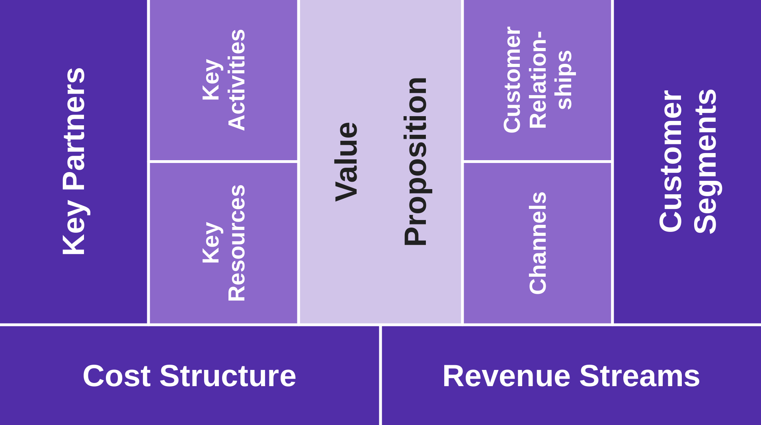
1. Create Hypotheses (Problem-Solution Fit)
Turn the product vision into a proposed business model
  Using the business model canvas
Turn the business model into testable hypothesis
  Write short summaries for each hypothesis
Align each hypothesis with a BMC section
  Value proposition (problem)
    Customer want/need
    Channels
  Value proposition (market type)
    Customer relationships
    Key resources
    Key partners
    Revenue streams

Slide 30
Products and Channels for the Digital World
Books
Software
Digital
Channel
Food
Events
Physical
Physical
Digital
Product

Slide 31
Questions to Ask / Hypotheses to Describe
KP
KA
VP
CR
MS
By category, ask
Who they are
What they provide
What you provide
Ask, what
Capabilities and
Activities you need
Describe
The market you are in
The competition you face
Describe
How to fulfill wants/needs
A minimum viable product
Describe your
Customer acquisition
Retention, and
Growth strategy
Describe
Market segments
Customer wants/needs
(Customer) personas
KR
CH
By category, ask
What you need
How much
Where to find them
At what cost
Describe
How the product gets from company to customer
C$
Describe
Fixed costs
Variable costs per unit
Assumed economics
  Of scale
  Of scope
R$
Of product sold, describe
Expected quantities
At what prices
Assess
market sizes

Slide 32
Create Hypotheses (the Open Source Way)
Listen to the community for insights and ideas
Talk to the community
Survey

Slide 33
2. Design Experiment (Problem-Solution Fit)
Design an experiment to test the hypotheses
In the initial stages, you don’t necessarily need code
A mock-up / sign-up / survey can provide the needed information

Slide 34
Minimum Viable Product
The minimum viable product (MVP)
  Represents the value proposition for testing
  In a minimal form that answers the test
The MVP is minimal in terms of
  Features customers need
  Development costs

Slide 35
The Minimum Viable Product Over Time
Phase | Action | Goal
Customer engagement preparation | Build a low-fidelity MVP Drive a little traffic to MVP | Test customer problem/need Assess significance
Low-fidelity problem test | Slowly increase acquisition Closely study customer behavior Meet customers face-to-face | Understand problem/need Learn how to explain problem Keep assessing significance
High fidelity problem test | Increase customer acquisition Monitor speed of acquisition | Test solution (do customers buy?) Determine early evangelists
Customer acquisition optimization | Scale up customer acquisition | Optimize customer acquisition

Slide 36
Design Experiments (the Open Source Way)
Open source lets you design and run experiments in parallel
  Let the community explore options (their own experiments)
  Lead community to design and implement your experiments
  At a university, you can use student theses to design experiments

Slide 37
3. Test Hypothesis (Problem-Solution Fit)
Run the experiment as designed and collect the needed information

Slide 38
Test Hypotheses (the Open Source Way)
Get users through open source project community
Test hypotheses through up-sell

Slide 39
4. Derive Insight (Problem-Solution Fit)
Analyze the data and determine validity of hypotheses
Based on overall validity (or lack thereof) decide to pivot

Slide 40
Derive Insight (the Open Source Way)
Openly discuss findings / mirror back findings to community
Listen to and learn from the response to identify biases

Slide 41
Pivot or Proceed?
Based on analysis, decide whether to pivot or proceed

Slide 42
5. Product-Market Fit

Slide 43
Finding Product-Market Fit with Customer Validation
Customer validation is a search process that
  Tests whether the discovered business model is repeatable and scalable
Product-market fit
  Is the matching of all value propositions with their market segments

Slide 44
After Customer Discovery…
You have a tested business model that delivers value to customers
  Your initial market sizing suggests the market is worth your efforts, but
  Your customer discovery tests are not representative
Customer validation will now test the market in its entirety
  By testing and validating how to scale the business
  Do you have product-market fit for the assumed market?

Slide 45
Testing for Both a Scalable and Repeatable Business Model
Scalable
  After an initial startup, will CLV >> CAC consistently?
  Is customer acquisition (sales funnel) predictable?
Repeatable
  Can you consistently and predictably sell?
  Can you consistently produce and deliver?

Slide 46
The Customer Validation Feedback Loop
Generate hypotheses
  Decide on most promising market segments
  Decide on most promising channels and relationships
Design experiment
  Prepare MVP and collateral with market and reach in mind
  Prepare for priming and using channels
Test hypotheses
  Instrument! Be ready to collect data! Then:
  Fill channels, let sales work
Derive insights
  Analyze data, possibly revise business model
  Stop if stopping criterion is reached

Slide 47
Demand Creation (the Open Source Way)
Word-of-mouth marketing
  Social media
  Conferences
Practitioner conference talks
Research conference talks

Slide 48
Pivot or Proceed
Before you start, define a stopping criterion for customer validation
  For example, sales volume reached or number of customers acquired
Only after stopping criterion is fulfilled, proceed to customer creation

Slide 49
6. Product-Channel Fit

Slide 50
Product-Channel Fit
Product-channel fit
  Is when the product fits your channel, that is, the product’s features are optimized for
    Growth (initially)
    Throughput (later)

Slide 51
6. Startup Metrics

Slide 52
Business Model Metrics
Customer lifetime value (CLV) and costs (CLC)
Customer acquisition (CAC), retention, growth costs
Annual / monthly recurring revenue (ARR / MRR)

Slide 53
Startup Survival Metrics
Cash burn rate
No. months of cash left
Time to cash-flow break even

Slide 54
Summary
Definition (startup)
The search process
Problem-solution fit
Product-market fit
Product-channel fit
Startup metrics

Slide 55
Thank you! Questions?
dirk.riehle@fau.de – https://oss.cs.fau.de
dirk@riehle.org – https://dirkriehle.com – @dirkriehle
DR

Slide 56
Legal Notices
Licence
  Licensed under the CC BY 4.0 International license
Copyright
  © 2020-2021 Dirk Riehle, some rights reserved

